Slide 1






School Mobility Plan
Mobility committee
Good examples
Commuting sustainably to school

Slide 2
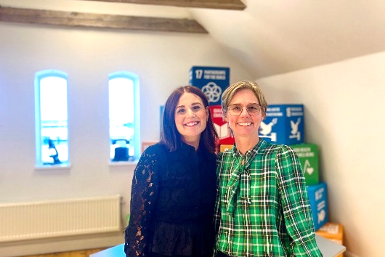
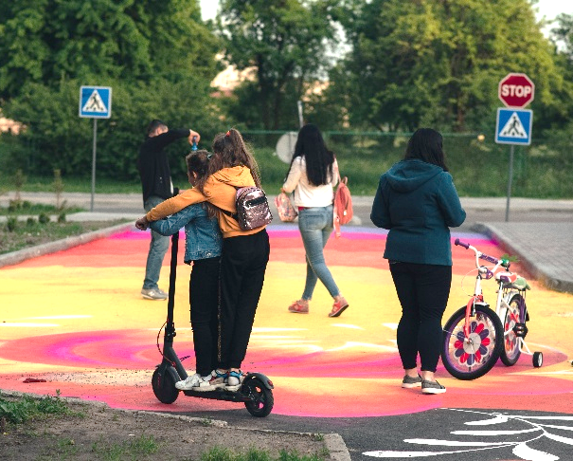
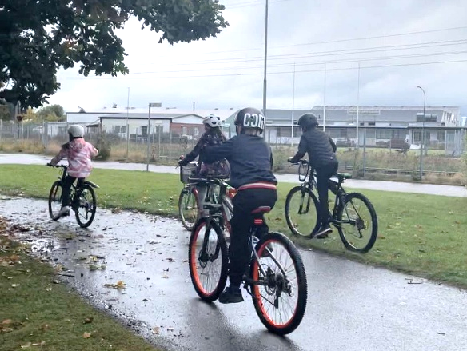
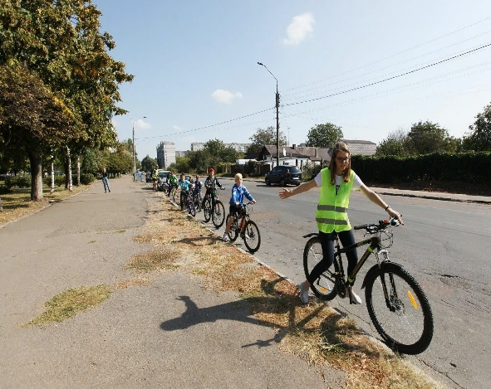
Benefits of sustainable mobility
Photo workshop facilitators
by Emelie Knifström
Photo by TUMI get to school sustainably
Photo: School by Bike by Stana Franjic

Slide 3

School Mobility Plan
A School Mobility Plan is a strategic initiative
to design and implement
sustainable and safe transportation options
for students, staff, and visitors
commuting to and from school.

Slide 4
School mobility plan - aim and work focus
Reliable Transport modes/alternatives
Walkability and Biking
Traffic Safety
Environmental Impact
Inclusive Access

Slide 5

School mobility plan – main stages
Composed by:
Baseline assessment
Planning
Implementation
Follow up

Slide 6






School Mobility Plan - Activities
Awareness
Raising
Community engagement
Education
Campaigns
Safety Measures
Inform policy and planning

Slide 7
Roles different actors can play
Schools
Municipalities
Parents
Students

Slide 8


School Mobility committe
A School Mobility Committee
typically refers to a group of stakeholders
within a school community
that focuses on improving
transportation, access, and mobility
for students, parents and staff.
The goal is to create a more convenient, safe, and sustainable environment for the school community, particularly related to how students get to and from school.

Slide 9

School Mobility committe – members composition
Who to invite?

Slide 10
School Mobility committe - tasks
Goal definition
Data and Research
Plan and manage
Implement/engage relevant group
Follow up: evaluate the impact

Slide 11
School Mobility Committe – meeting structure
Kick off
baseline meetings
Plan and prioritize activities
implementation progress
Follow up up

Slide 12
Setting the baseline
Overview of current transport moodes
Needs and concerns about sustainable /active mobility
Wishes and level of interest in sustainable mobility

Slide 13
What kind of action? Levels of engagement
Awareness raising
Trying it out towards recreational use
From recreation to commuting

Slide 14
GOOD EXAMPLES

